Slide 1


Student Performance Evaluation
Group-2

Slide 2

Course ID: CSE 303
Section : 2
Faculty: Sadita Ahmed
Team member:
Niaz Uddin 1720102
Rashida Akter Afnan 1721897
Tanjim Ahmed Pranto 1721450
Tasfiat Zabir Khan 1630545
Daniel Gomes 1822007
Shahnewaz Muhammad Rajit 1630736

Slide 3

Table Of Contents
1. Rich Picture (As-is)
2. Six Elements (As-is)
3. BPMN (As-is)
4. Problem Analysis
5. Rich Picture (To-Be)
6. Six Elements (To-Be)
7. BPMN (To-Be)
8. ERD
9. Relationship Schema
10. Normalization
11. Data Dictionary
12. Template

Slide 4
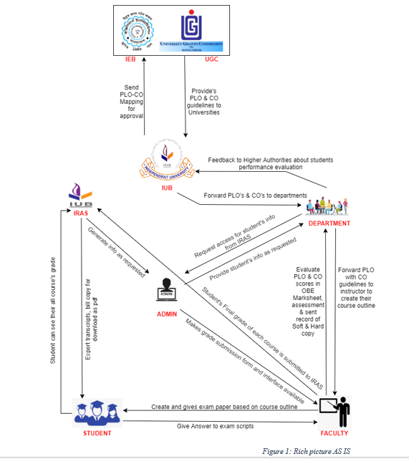
RICH PICTURE (AS-IS)

Slide 5
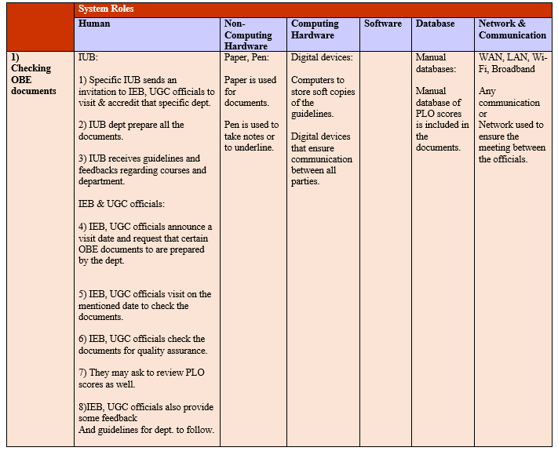
SIX SYSTEM ANALYSIS (AS-IS)

Slide 6
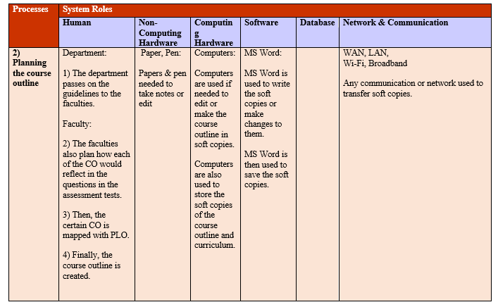

Slide 7
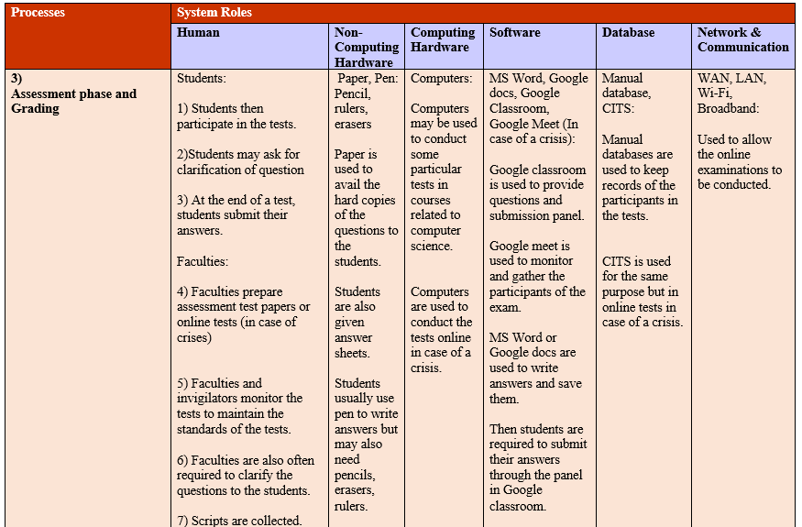
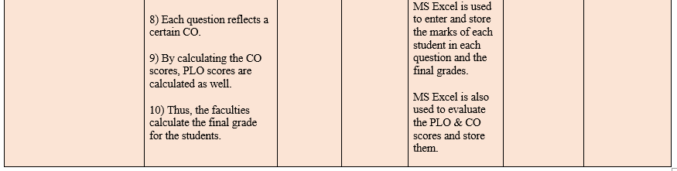

Slide 8
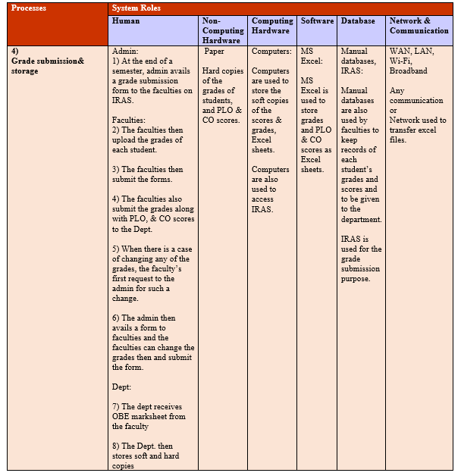

Slide 9
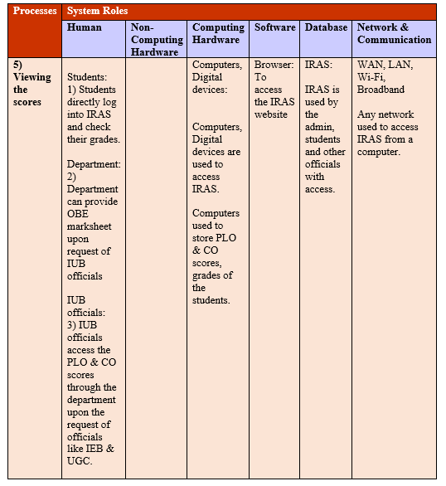

Slide 10
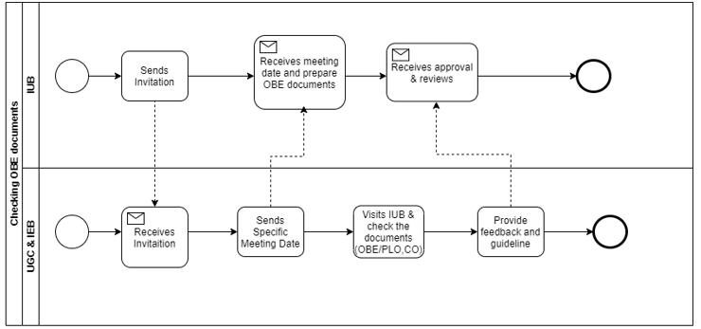
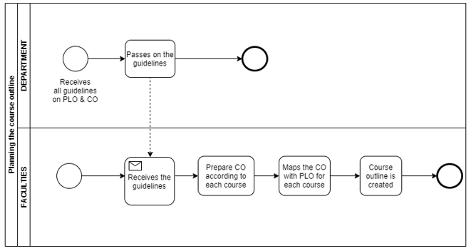
PROCESS DIAGRAM (AS-IS)

Slide 11
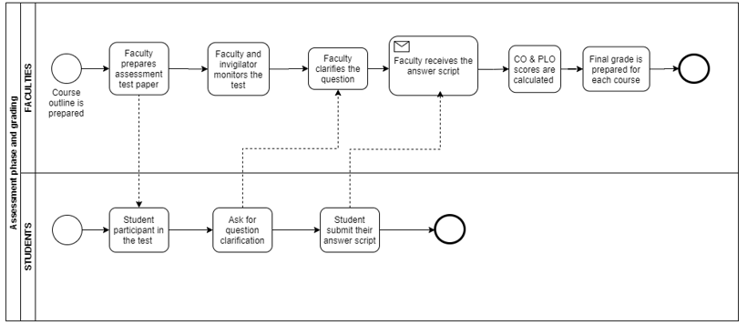
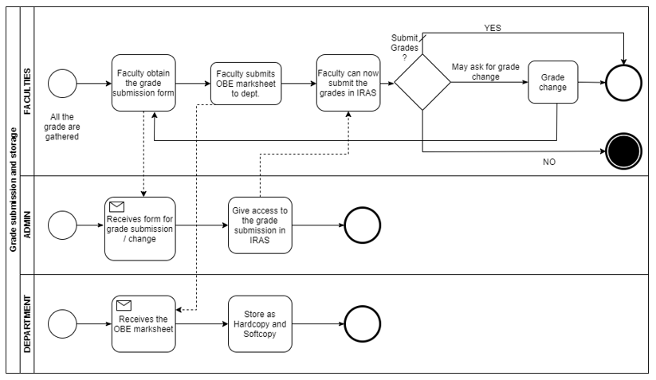

Slide 12
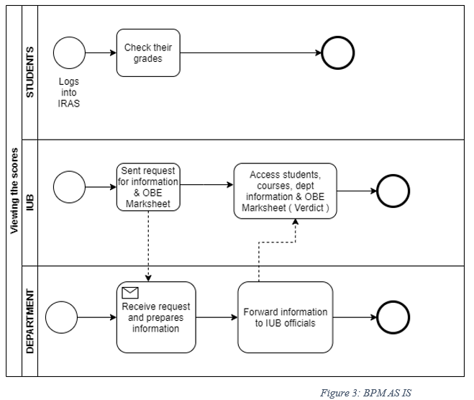

Slide 13
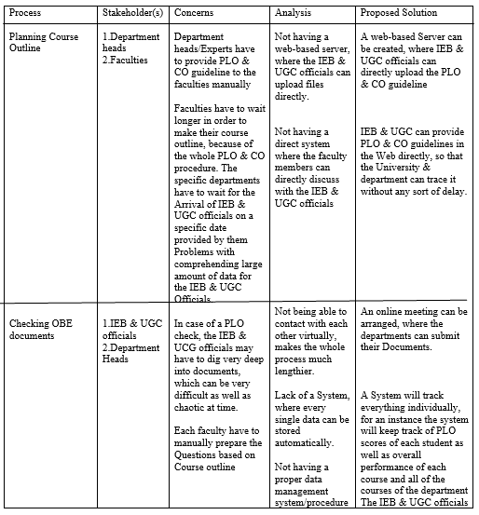
PROBLEM ANALYSIS AND THE EXISTING SYSTEM

Slide 14
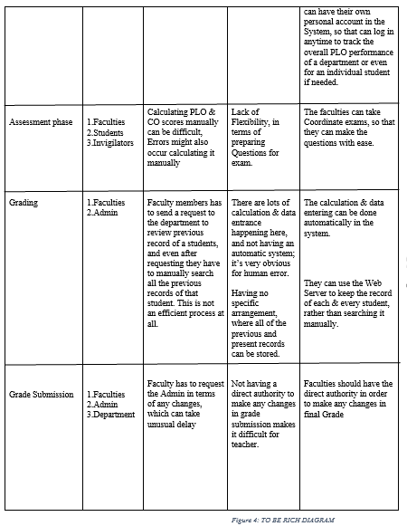

Slide 15
PROPOSED SYSTEM

Slide 16
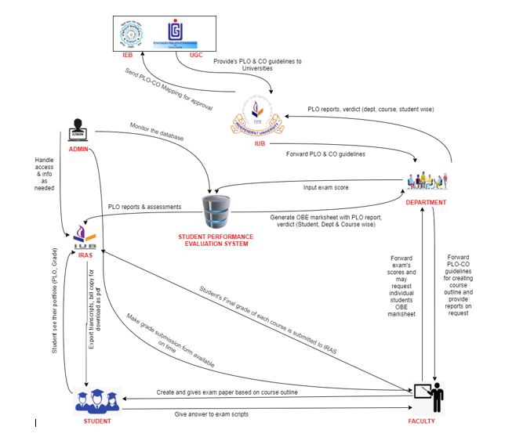
RICH PICTURE (PROPOSED)

Slide 17
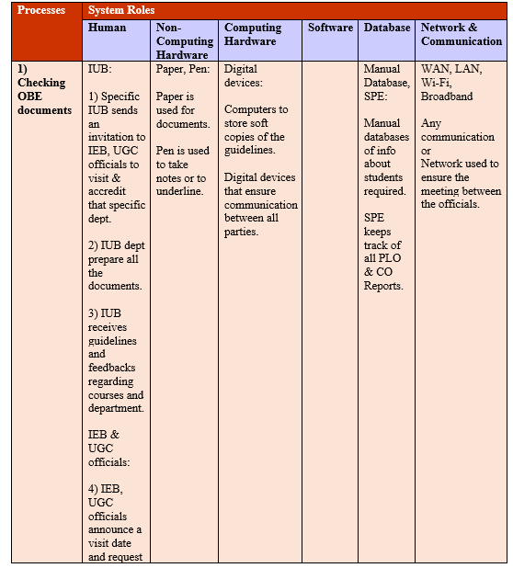
SIX ELEMENT ANALYSIS (PROPOSED)

Slide 18
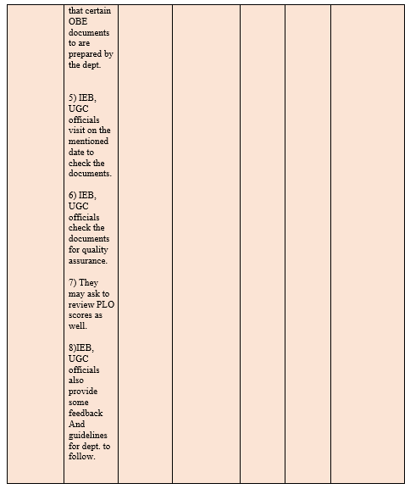

Slide 19
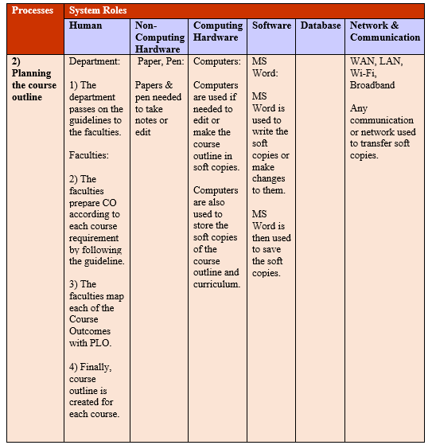

Slide 20
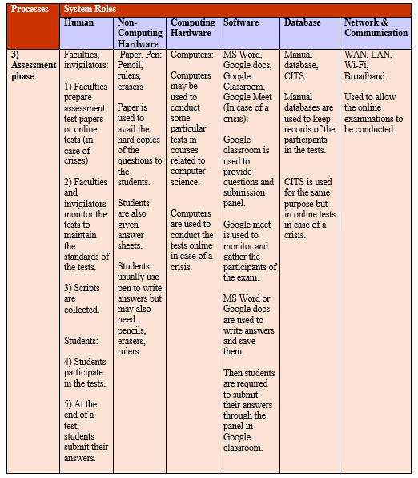

Slide 21
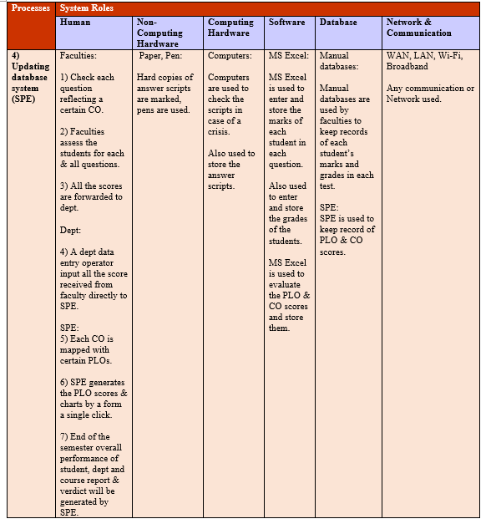

Slide 22
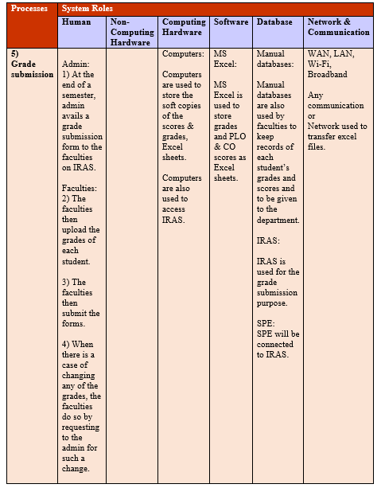

Slide 23
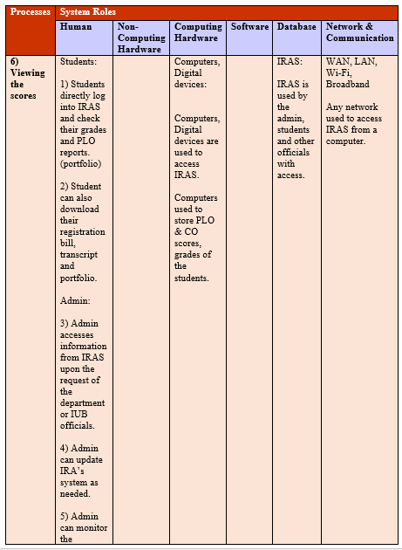

Slide 24
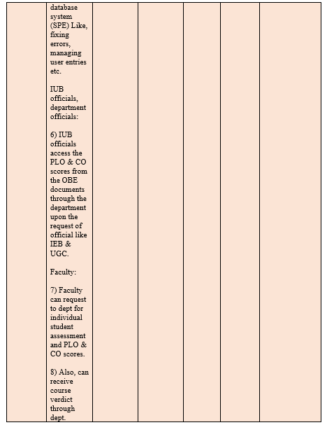

Slide 25
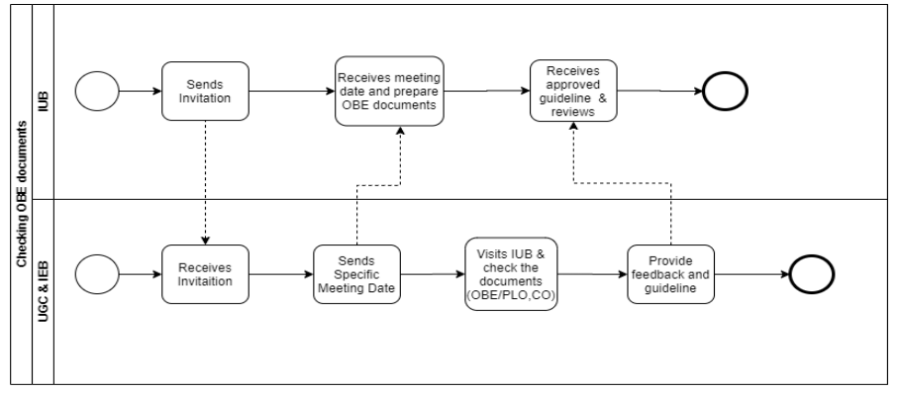
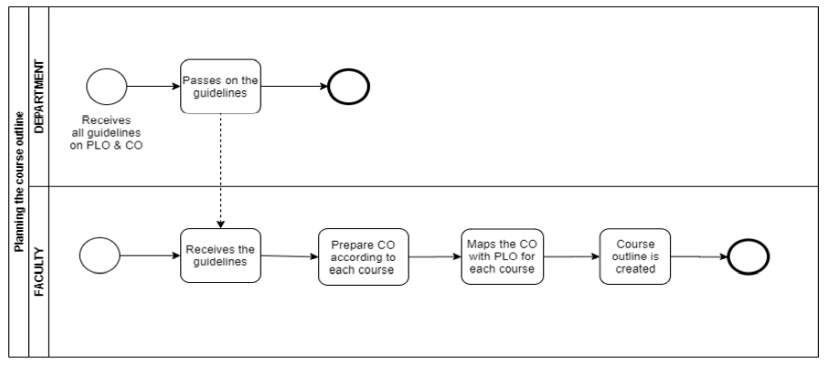
PROCESS DIAGRAM (PROPOSED)

Slide 26
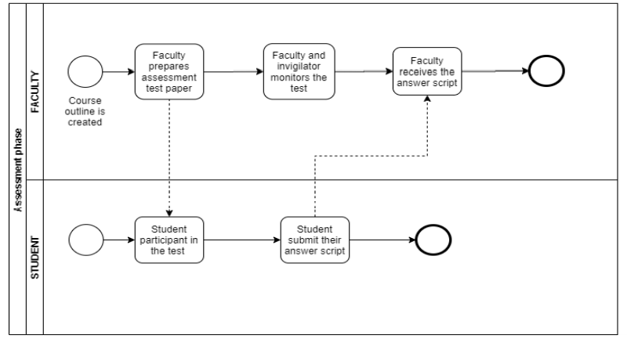
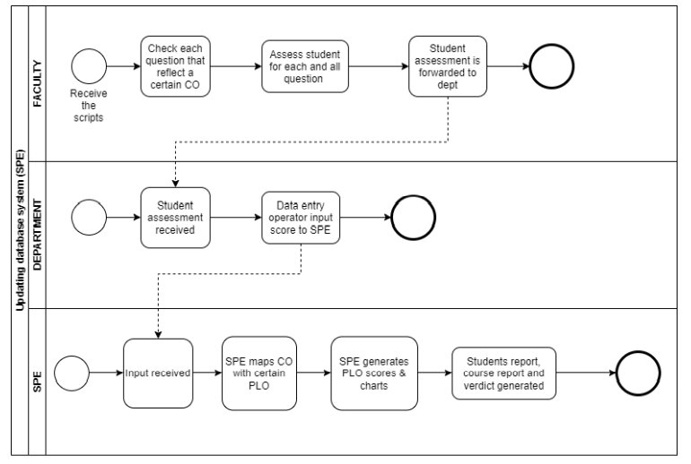

Slide 27
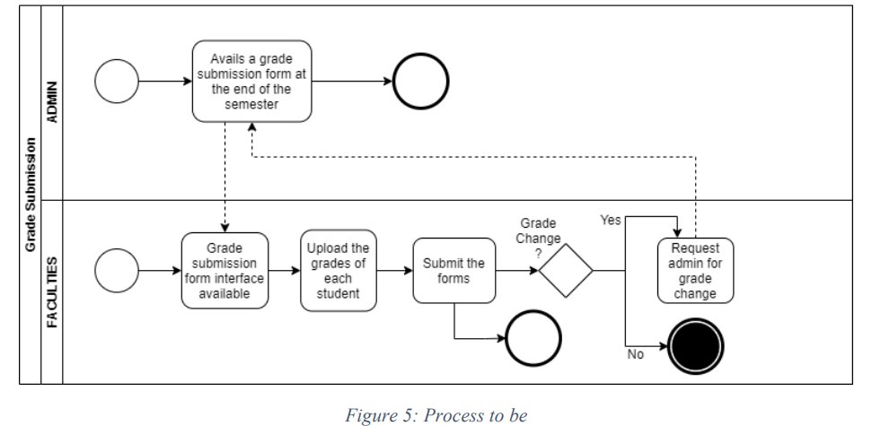
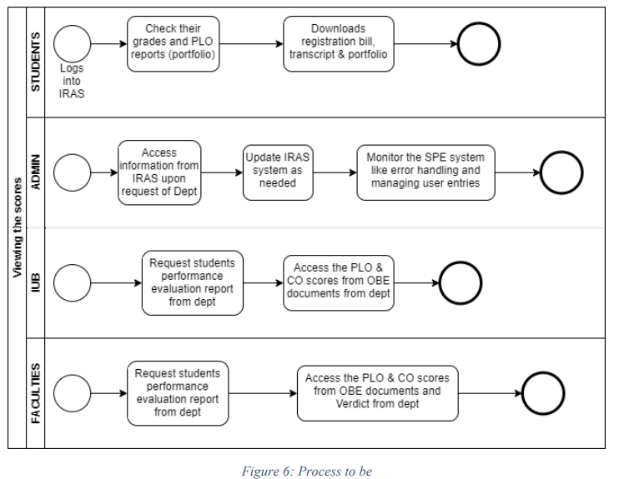

Slide 28
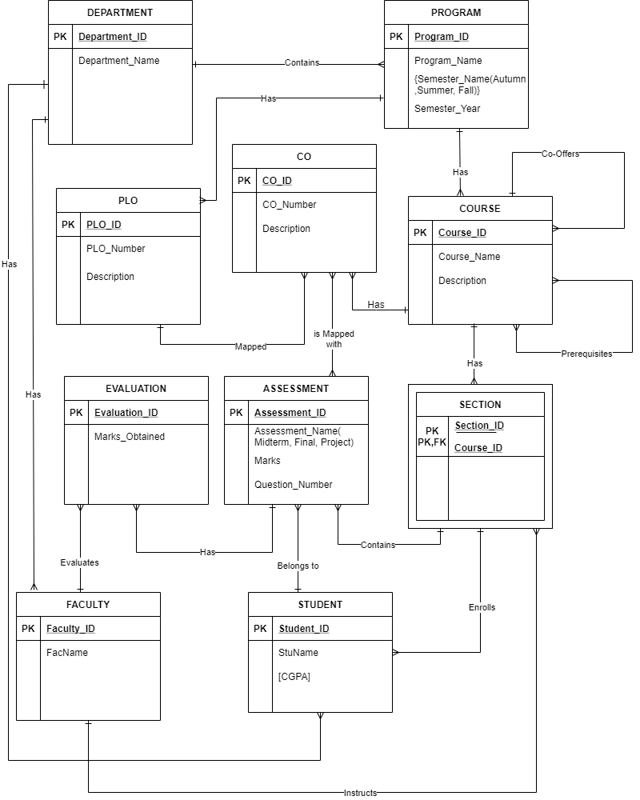
ENTITY RELATIONSHIP DIAGRAM (ERD)

Slide 29
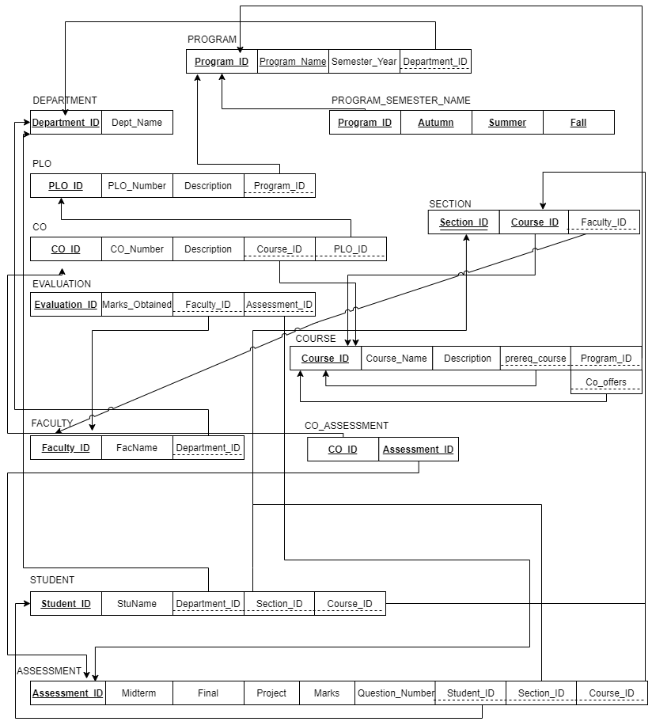
RELATION SCHEMA

Slide 30
NORMALIZATION
1NF: It is arranged in a way where relation has a primary key and there are no repeating
groups, so far, so it is in 1NF.
2NF: Since non-key attributes are fully dependent on the composite primary key, so it is in 2NF.
3NF: Since there is no transitive dependency, so it is in 3NF.
BCNF: Since a non-key cannot identify a candidate key or part of it, so BCNF will not
be applied.

Slide 31
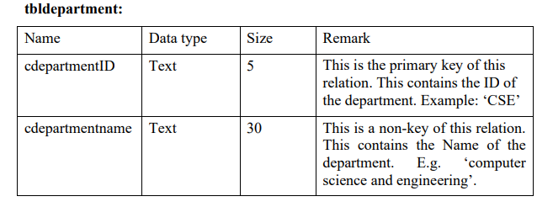
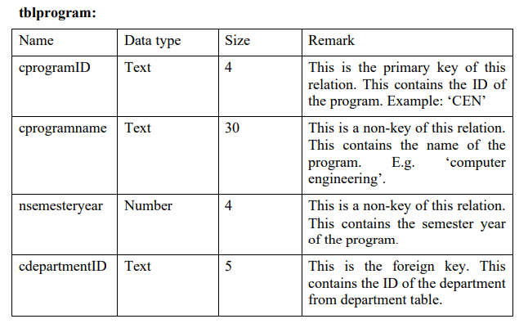
DATA DICTIONARY

Slide 32
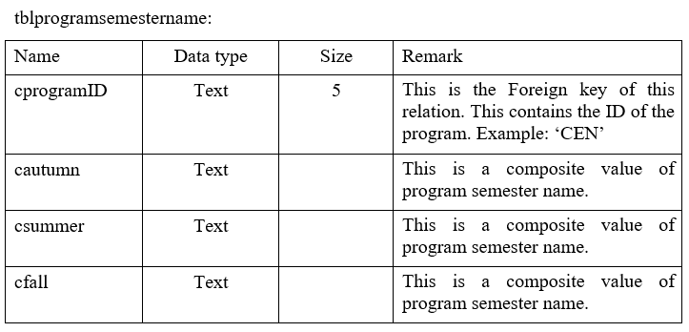
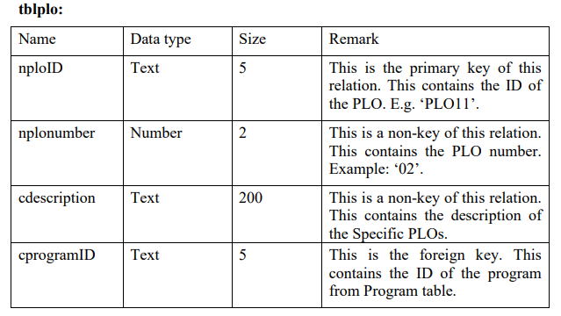

Slide 33
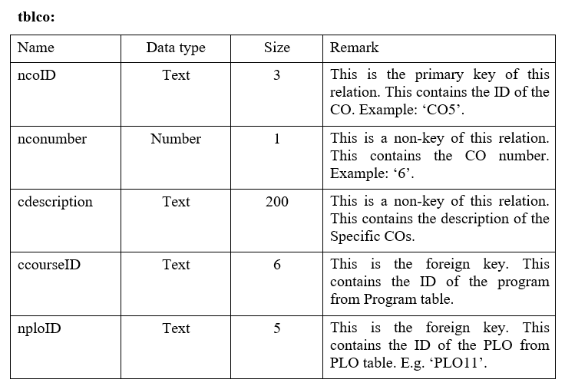
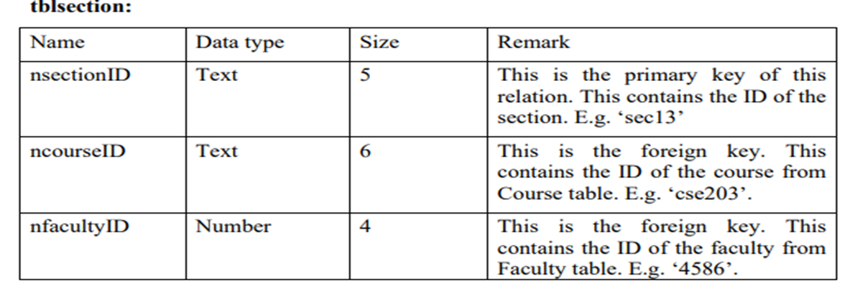

Slide 34
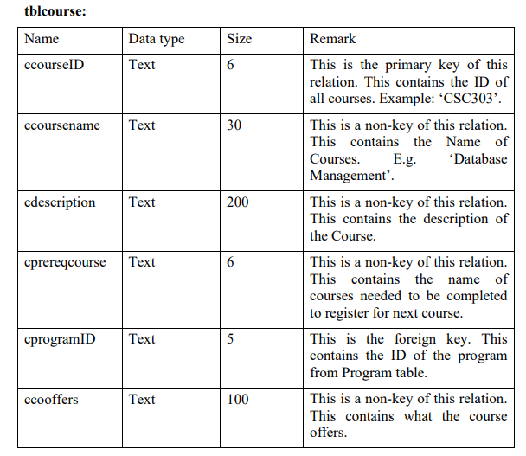

Slide 35
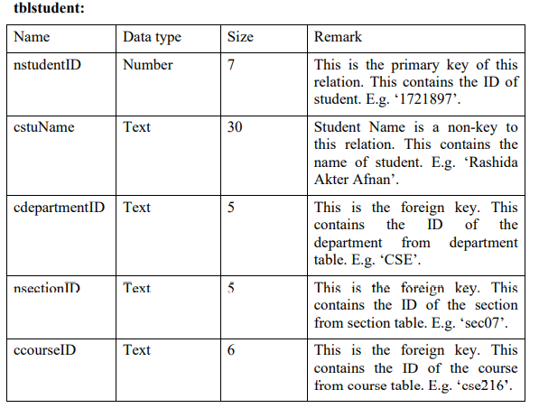
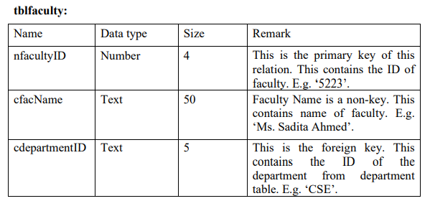

Slide 36
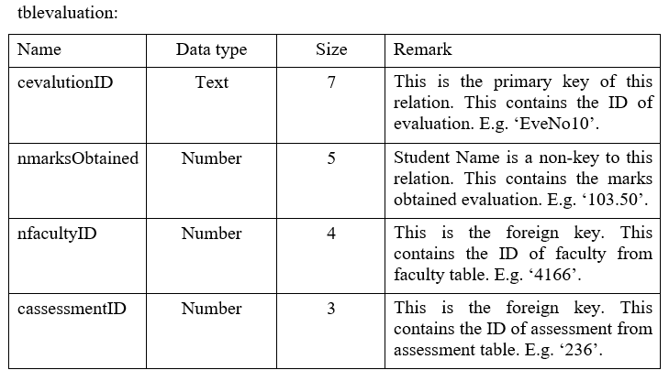
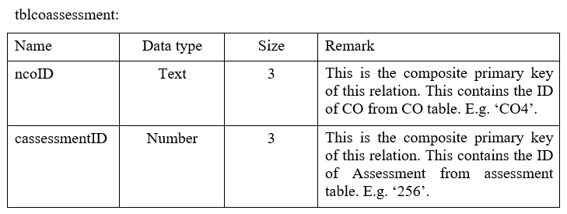

Slide 37
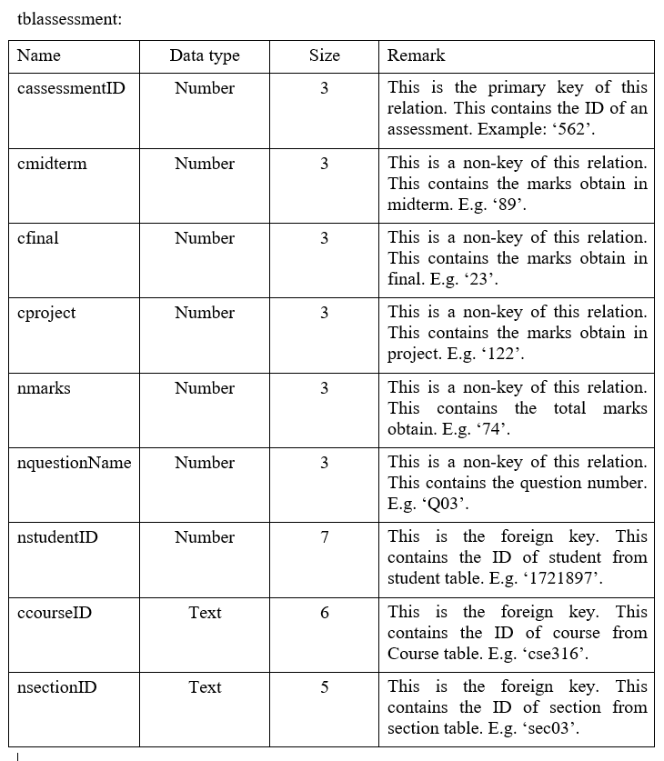

Slide 38
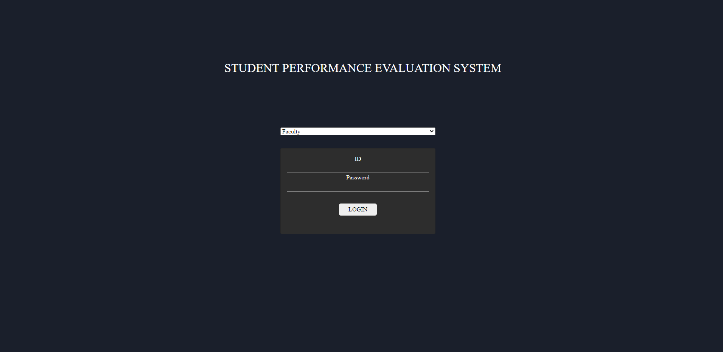
TEMPLATES

Slide 39
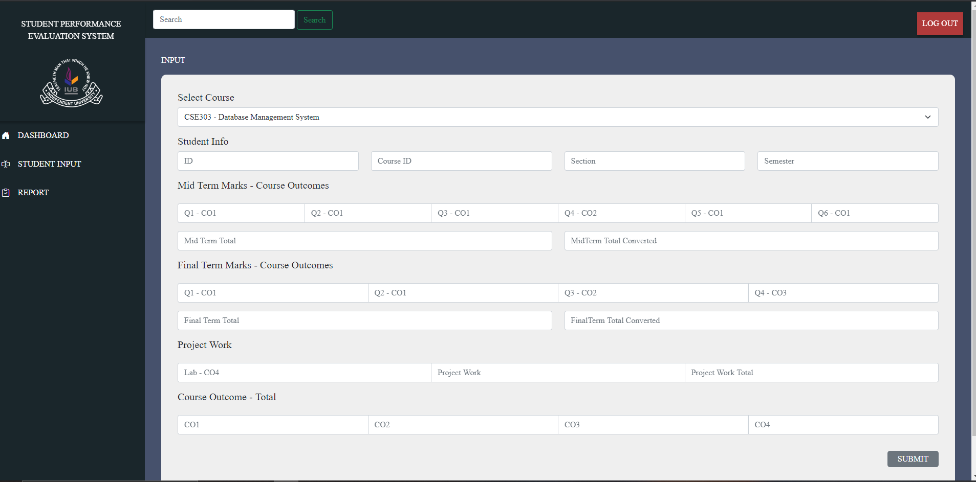

Slide 40
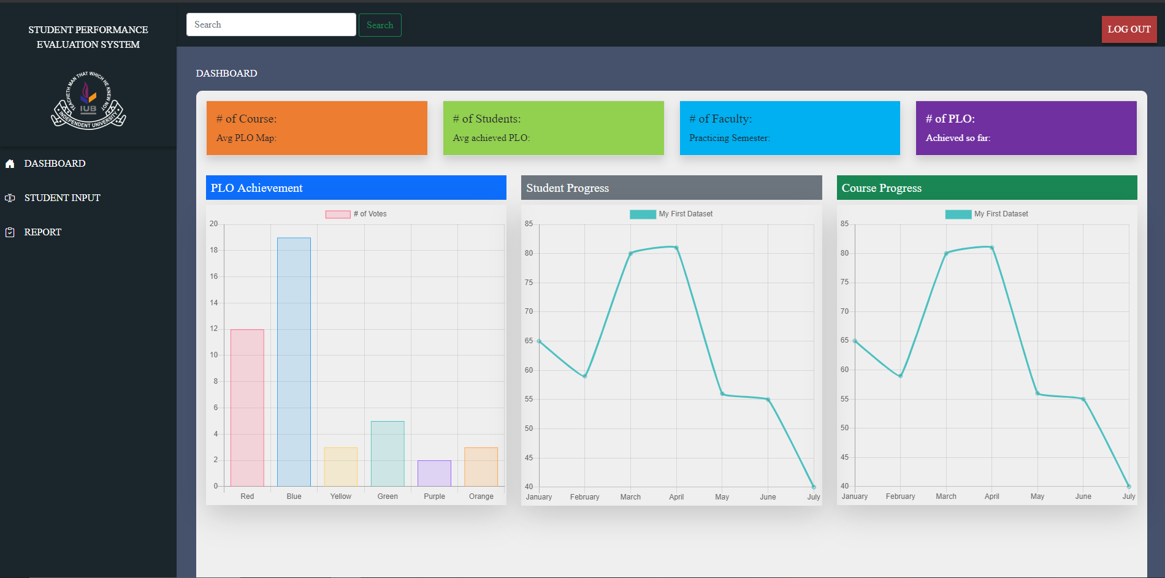

Slide 41
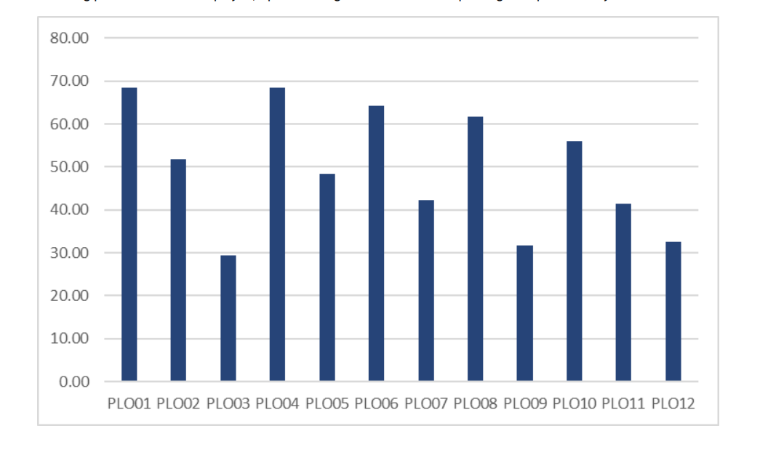
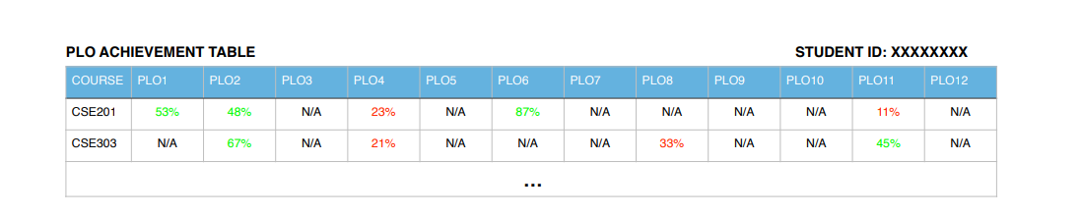

Slide 42
THANK YOU

